Slide 1
Extracting Microcontent from
DITA Topics
Advantages of TRANSFORM ON DEMAND

Slide 2
A Case Study
How we bring Microcontent into the product GUI, using DITA Single Source.
How Transform On Demand works for us, and some interesting concepts that it reveals.

Slide 3
Introductions
Chris Despopoulos
Publications Manager @ Turbonomic Inc.
(an IBM company)
Technical Writing for decades
Built plugins and tools for FrameMaker
Been with Turbonomic for 10 years
Designed and implemented 4D-Pubs:
In-browser transformation of DITA to HTML

Slide 4
Disclaimer
This content is provided for informational purposes only. The opinions and insights discussed are those of the presenter and do not necessarily represent those of the IBM Corporation.

Slide 5
Background: Turbonomic Product
We Do Application Resource Management
Turbonomic AI-powered Application Resource Management simultaneously optimizes performance, compliance, and cost in real time.
Software manages the complete application stack, automatically. Applications are continually resourced to perform while satisfying business constraints.
Application Resource Management
Visibility
(Full-Stack)
Continuous
AIOps Platform
Analytics
(Prioritization)
Real-Time and Over Time Data
Common
Data Model
Actions
(Resourcing Decisions)

Slide 6
Product and Doc Delivery
Turbonomic is delivered as a Virtual Machine or Kubernetes cluster that hosts the back-end process. This platform serves the User Interface as a Web App.
The same platform also serves the online docs which display as HTML in a Web App.

Slide 7
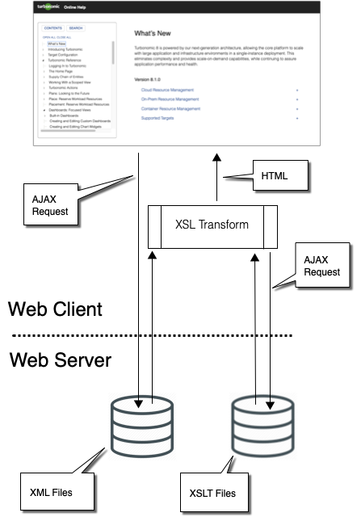
Doc Overview
Doc Source: DITA
Doc Display: Single-Page App
    Static on the server side
    Dynamic on the client side
We transform the DITA on request, in the browser.
Transform on Demand is important
We can adjust help on the fly
No build of the online help (Agile, saves $$$)
We get to think differently…

Slide 8
Shipped
Transform on Demand: Advantages
Demonstrated but no business case
Role-based content
Variable GUI Coverage
Swagger-ish API doc
Integrate with Social Content
Rebranding
Product Flavors
Walk-throughs
Quick Help
One help from multiple sources
    e.g. doc assets on different components
API call/response
    Wizards & tutorials
    Plugin framework (custom d3.js pages)
Intelligent Quick Help
    Pass GUI state within QH call

Slide 9
Architecture
Listen for URL changes and overall control
Doc_Controller
Single point to launch help window
Help Launch Service
Manage TOC and Search
TOC Service
Search Service
Keyref Service
Conref Service
Transform Service
DITA-specific services
Keyref is key to flavors & rebrand
General utilities
Doc Utilities
Dictionary of custom functions
Extension Service

Slide 10
Load & Transform XML
Doc_Controller
Help Launch Service
Transform Service:
AJAX to get XML and XSLT files
Executes transform
Keyref Service:
Expands keyrefs
Conref Service:
Recursively expands conrefs
Can call Extension Service
TOC Service
Search Service
Keyref Service
Conref Service
Transform Service
Doc Utilities
Extension Service
We can:
Call different XSLTs at will
Modify the XSLT before running a transform
Use variable content (keyrefs, conrefs)
Generate content programmatically (Extension Service)

Slide 11
Custom Functions
Doc_Controller
Help Launch Service
Extension Service:
A dictionary of functions. A way to inject JS into the help app without using inline code. Used for:
Accordions
Open Help
Start Walkthrough Tours
Automatic list of sub-topics
Execute product API calls
Other???
TOC Service
Search Service
Keyref Service
Conref Service
Transform Service
Doc Utilities
Extension Service

Slide 12
Let’s Pause…
We Have A Help System That Is:
Static on the server
Dynamic in the client
Responds to user role & product flavor
Can be extended with custom functions
This is possible and/or useful because of Transform on Demand.

Slide 13
Introducing Quick Help
For a Deeper Dive, let’s look at Quick Help (QH).
QH is Doc-in-GUI.
With QH, we tease apart DITA topics to deliver micro-content in the user interface.

Slide 14
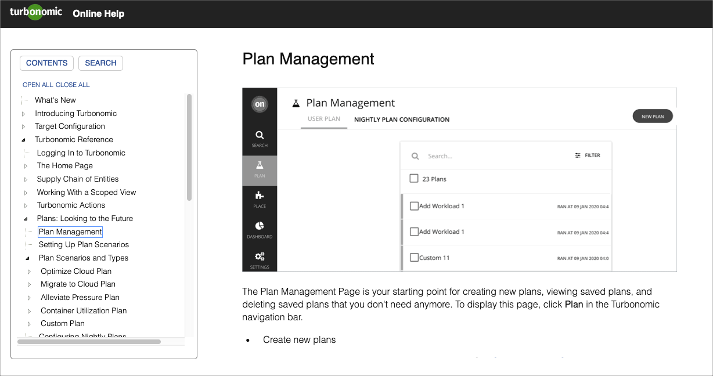
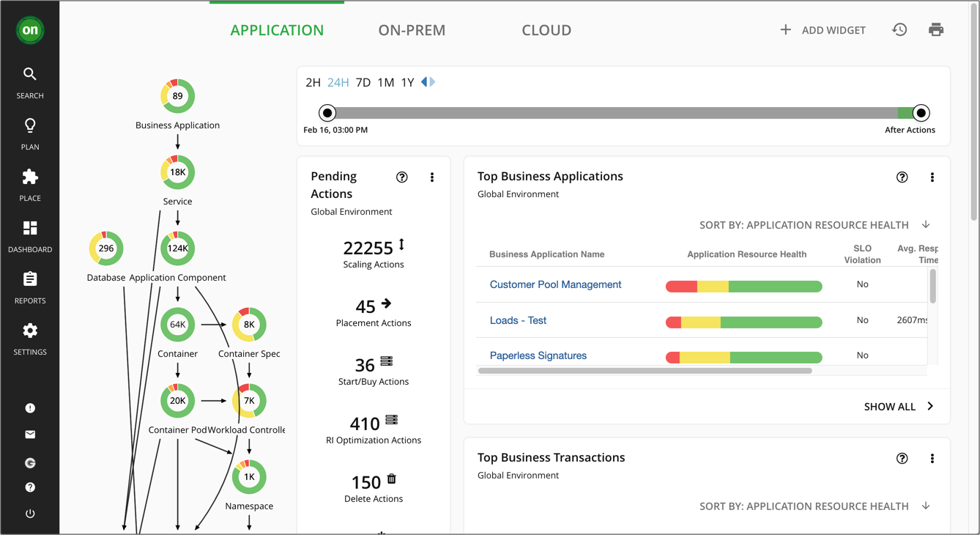
An App is an App…
The Doc App is a Web GUI that displays data – Just like the product application.
So why not display doc content in the product GUI?

Slide 15
…Is an App
Doc_Controller
Help Launch Service
With just the DITA services, doc utilities, and extension service, we get Doc-in-GUI
TOC Service
Search Service
Keyref Service
Conref Service
Transform Service
Doc Utilities
Extension Service

Slide 16
Strategy
Tactics
Bring content closer to the user
Single Source (of truth)
Connect to the long-form doc
Blur the line between GUI and DOC
Exploit the Doc App
Maximize control on the Doc side
    We own the transforms
    We own the topics
    Meta-data declares topic subsets
GUI-to-Topic Mapping:
    JSON file owned by Pubs
Authoring/Publishing:
    Minimal changes to our process
    Sustainable

Slide 17
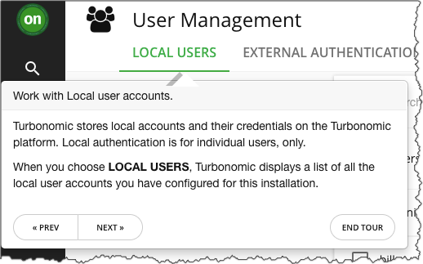
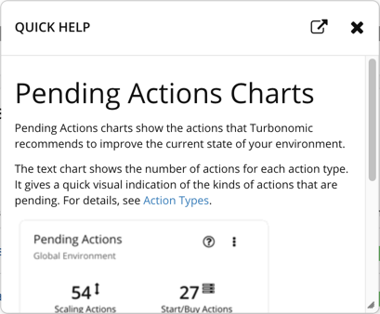
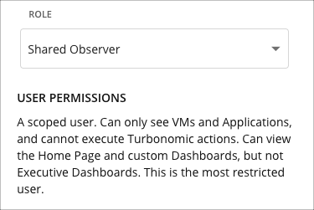
Three Microcontent Types
1
Walk-Through
2
Quick Help Panel
3
Inline Quick Help

Slide 18
QH Panel: Extracting Microcontent From Topics

Slide 19
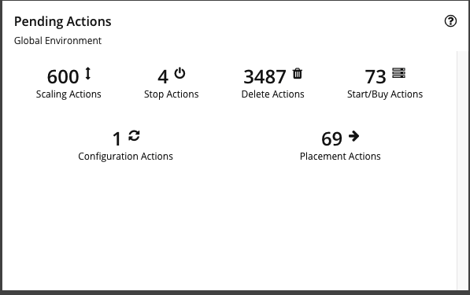
Click icon in chart to request a QH ID.

Slide 20
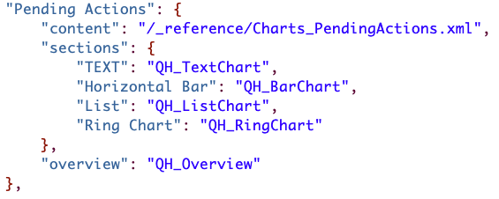
The request looks up the ID in the QH Map (Pending Actions)
The QH request gets data from the QH map entry:
The map specifies a default XSLT
CONTENT field identifies the topic
OVERVIEW field gives metadata for overall content for this request
SECTIONS fields give metadata for sub-topic content (per chart type in this example)

Slide 21
The app uses the map data to call the
Transform Service with:
Path to XSLT
Path to topic
XSLT param for main QH content (QH_Overview)
XSLT param for this specific chart type (QH_TextChart)

Slide 22
Transform Service:
Loads the XSLT and Topic files
Passes the params to the XSLT
Executes the transform
Returns the generated HTML to the app
Keyref Service
Conref Service
Transform Service
Doc Utilities
Extension Service

Slide 23
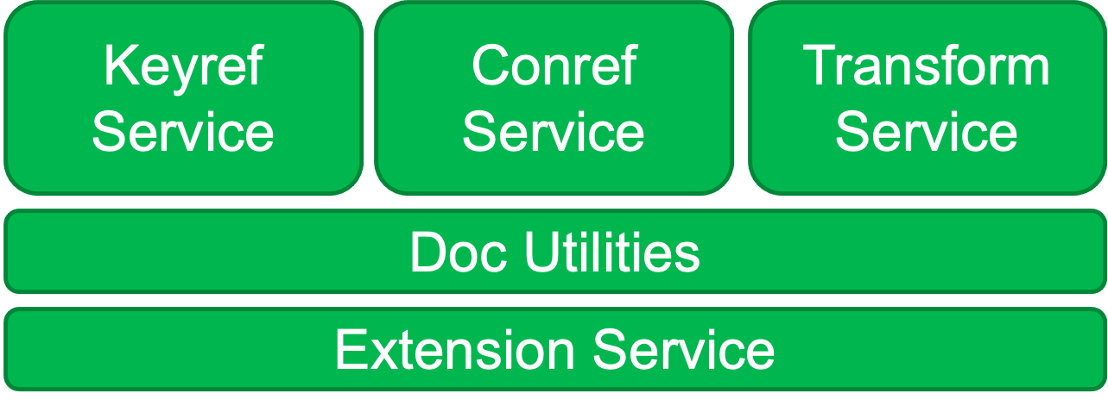
The app displays the transformed result in a QH panel.

Slide 24
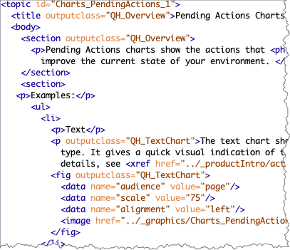
Doc Asset
Uses outputclass
QH_Overview
The title and generic overview for
this QH
QH_TextChart
This content only shows if the GUI
widget asks for the TEXT section
NOTE: We decompose the <ul>
and <li> elements

Slide 25
QH Panel Transform
Transform on Demand means:
We can filter the same topic in different ways
No need for separate copies for each QH assembly – Doc build remains trivial
Dynamic results – No processing on the server side
The transform request sends the outputclass values as paramaters to the XSLT
XSLT only applies to elements with matching outputclass
To get a full topic into the panel, pass no paramaters

Slide 26
Let’s Pause…
Extracting microcentent from a topic reveals two interesting ideas:
Metadata as overlays
Transform rules as context

Slide 27
Metadata
As
Overlays
Think of a layer over a text that only exposes select words.
An overlay can extract specific meaning from a text.
One text can have multiple overlays.
You can think of overlay categories.
This paradigm could help manage texts as metadata gets more complex.

Slide 28
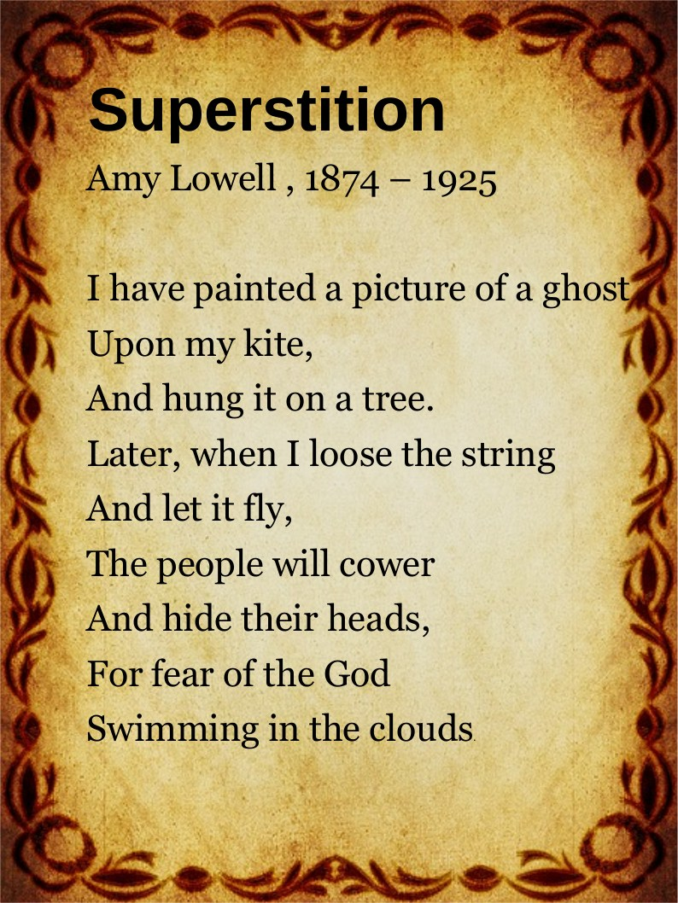
From this single text, we can get…

Slide 29
Two really different texts.
Two overlay categories.
You can ignore semantics!

Slide 30
Transform
As
Context
A declaration needs context to be meaningful.
A transform finalizes the context of markup.
  Format
  Filtering
  Other
You can have different contexts for the same text.
You can procedurally modify a transform on the fly.
You can pass context modifiers as parameters.
Let’s see how parameters can refine a context…

Slide 31
Parameters in QH
As we saw, a QH request includes paramaters that get passed into the transform.
What if the request passed more params to express the last-minute status?
Then QH could be personalized to reflect now.
The text can have a more specific context.
Examples:
Give real names of real people or entities interacting with the text
Discuss specifics of real-time data
Generate reports
Troubleshooting can respond to the current state

Slide 32

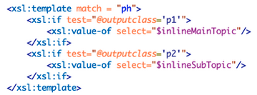
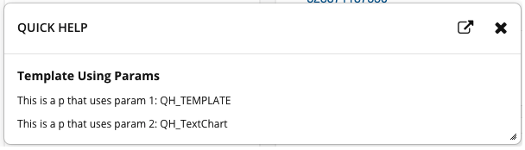
Templated Response
Assume the topic has slots for two vars:
And the transform handles them like so:
You can get the following QH:

Slide 33
In Summary…
We have Transform on Demand
We transform in the browser
We can slice and dice content with metadata overlays
We can play with context

Slide 34
The Good
Transform in the Browser
The Not-So-Good
Minimal server-side footprint
Technically, a Static Site
Portable – Easy to deploy
    Deployed to external site
    Integrated in product GUI
Surprisingly good performance
DITA topics are small by definition
Security
In-browser apps have special concerns
Browser differences
XSLT 1.0
Sluggish startup
Loading search data takes time

Slide 35
Transform in the Browser IS NOT THE POINT
The star of the show is Transform on Demand
Transform in the Browser is nice but limited
With a microservices architecture, why not deliver a separate doc component?
  Security is easier to handle
  Browser differences go away
  Search database can be huge (no transfer to browser)
  Can generate PDFs on the fly
  Can communicate with internal and external components

Slide 36

THANKS!

